Slide 1
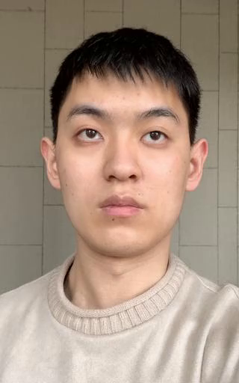
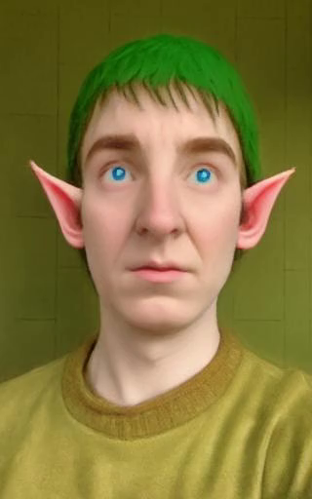
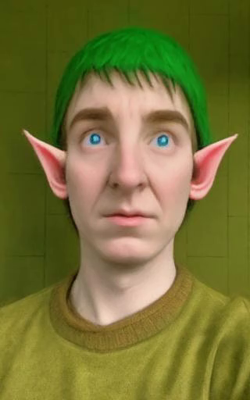
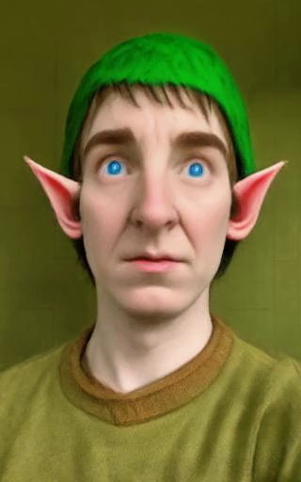
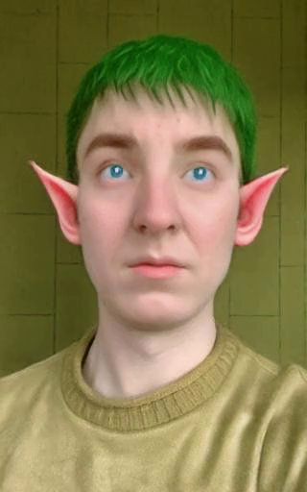
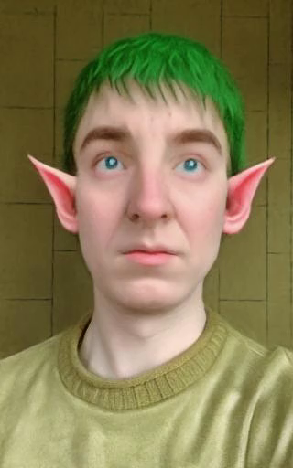
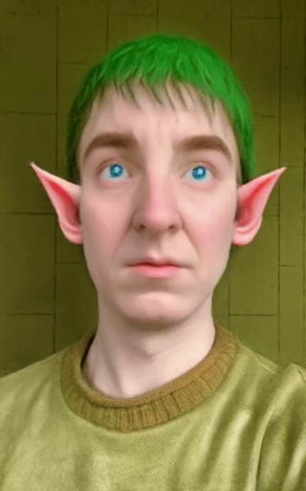
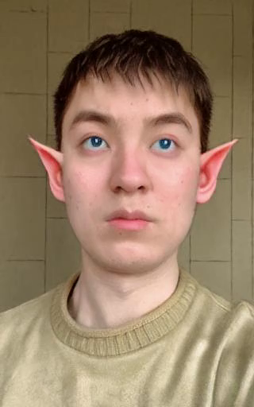
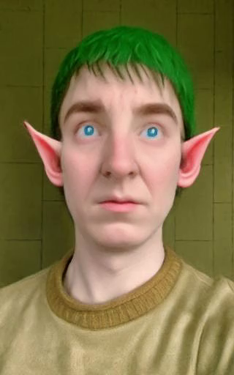
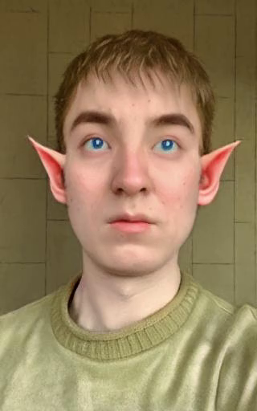
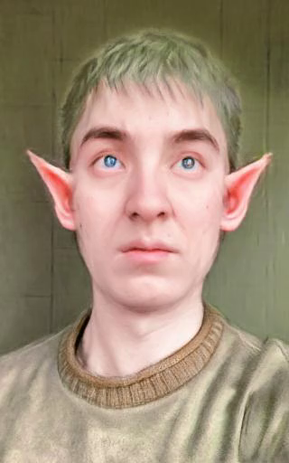
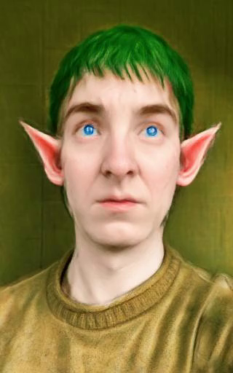
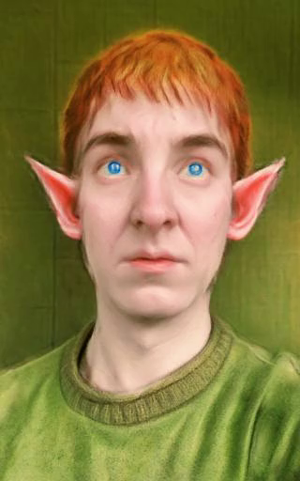
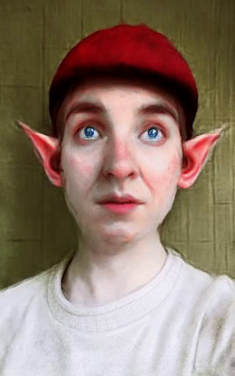
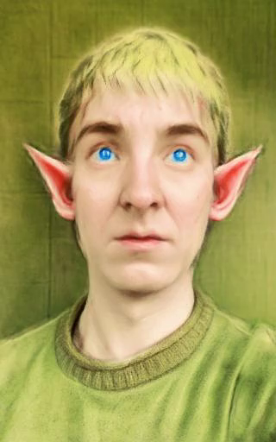
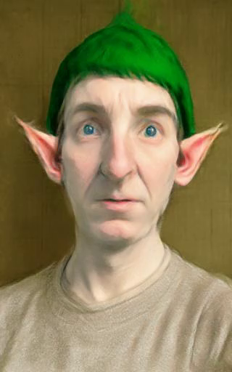
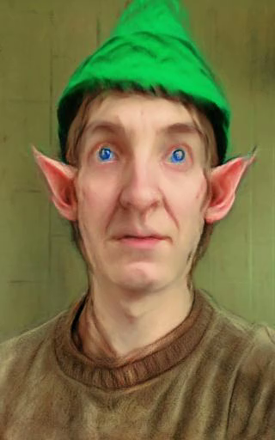
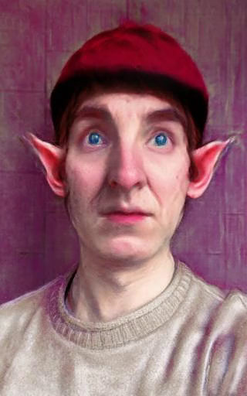
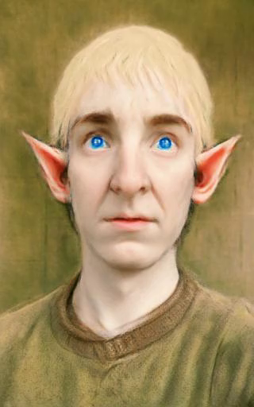
"Turn him into the Tolkien Elf"
Original
NeRF
IN2N
S_{I}=1.25 S_{T}=6.5
IN2N
S_{I}=1.25 S_{T}=7.0
IN2N
S_{I}=1.25 S_{T}=7.5
IN2N
S_{I}=1.5 S_{T}=6.5
IN2N
S_{I}=1.5 S_{T}=7.0
IN2N
S_{I}=1.5 S_{T}=7.5
IN2N
S_{I}=1.75 S_{T}=6.5
IN2N
S_{I}=1.75 S_{T}=7.0
IN2N
S_{I}=1.75 S_{T}=7.5
Original NeRF
Our
inference 1
Our
inference 2
Our
inference 3
Our
inference 4
Our
inference 5
Our
inference 6
Our
inference 7
Our
inference 8
Our
inference 9

